Slide 1
DEVELOPMENT MANAGEMENT PILLAR
Autonomous Maintenance
(Jishu Hozen)
Planned Maintenance
Quality Maintenance
(Hinshitsu Hozen)
Individual Improvement
(Kobetsu Kaizen)
Education & Training
Administration
(Office TPM)
Safety, Health &
Environment
Development
Management
TPM - The Prime Mover Towards Excellence
Notes:
Good afternoon Everybody. New product development is essential for the survival of any firm.
This training material is not intended to cover all the various strategies in design & Development department . but is intended to give a introduction to TPM in development department and a basic strategy for using TPM successfully. We will first discuss what DM is and how TPM activities are carried out in development departments. Then we will go through some methodologies & kaizen examples of one company that reduces their product development lead time ..

Slide 2
What is Development Management ?
To implement efficient Product development and Equipment investment with a view to reducing the time from product development to mass production start-up and realize full scale production after start-up.
Notes:
What is Development Management ? Before It was named as Initial Phase Management. Initial Phase management not included Market research & Planning & Design activities. & Development management covers all the activities also. DM means new product & equipment with shorten time period for design & manufacturing. & Realize minimum run up time & stable launching of new products & equipment operation.

Slide 3
Why DM ( Product) ?
Difficult to Survive
in competitive
world
Why DM ?
High Product
Development
lead time
Serious start-up
delay
High Rejection at
Volume production
Stage.
Notes:
What is Development Management ?

Slide 4
Why DM ( Equipment) ?
Difficult to maintain the equipment
Why DM ?
Difficult for operating the equipment
Equipment producing defective products
Possibility of accidents during equipment handling

Slide 5
AIM
Development of new products.
To develop products with minimum lead time
To ensure product functions as well as to achieve
“ Easy Quality assurance”
“ Easy Manufacturing”.
“ Achieve vertical start-up during volume production”
To introduce New products to market.
To meet the anticipated needs of Users/ customer.

Slide 6
AIM
To develop Equipments which are
Free from major losses
Easy to use
Easy to maintain
Does not manufacture defective products
It is to be safe.
Longer service life & minimum downtime for replacement of spares.

Slide 7
DM – Product & Equipment
Company must efficiently develop –
Competitive
Easy to manufacture
Defect free products
Meeting the anticipated needs of users.
Product Development
Company to manufacture equipment –
Free from 7 major losses.
Features the highest investment efficiency – Reliable
Easy to use.
Easy to maintain.
Doesn't manufacture defective products.
Has good origin.
To realize full scale production after start up
Equipment Development

Slide 8
DM – Team work
Cooperation amongst not only-
R&D
Design
PED
Production
Maintenance
Planning
Sales
Accounting
Quality Assurance
But Also –
Notes:
DM is not a individuals effort, it’s a team work. So cooperation amongst not only…..

Slide 9
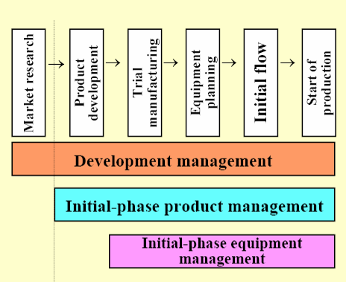
DM and Relationship between Initial-Phase Product Management & Equipment Management
In TPM, Priority is placed on Initial Phase Management of Products & Equipment.
Of course , such management activities are based on LCC & MP Design Technology.

Slide 10
LCC –Life Cycle Costing
LCC –Life Cycle Costing
- Cost required for the entire services life of Products or Equipments.
- It is the total cost that arise or is expected to arise in the processes of Design, Development, Production, Operation, Maintenance and Support.
- LCC to be used by Users economic.

Slide 11
MP –Maintenance Prevention
Design activities carried out during Planning and Construction of new equipment, that carryout for –
- High degree of Reliability
- Maintainability
- Economy
- Operability
- Safety
- Flexibility
- Considering maintenance information and new technologies
Because of that – Reduce Maintenance expenses.
- Deterioration Losses

Slide 12
MP –Maintenance Prevention
MP involves at the designing stage of new equipment so that new equipment will be
  Safe
  Easy to use
  Free from failures
  Easy to maintain.
  Free from defects.
  MP refers to the activities to study shortcomings of present equipment, to feedback study results to the design staff, and to enhance the Reliability of Equipment.

Slide 13
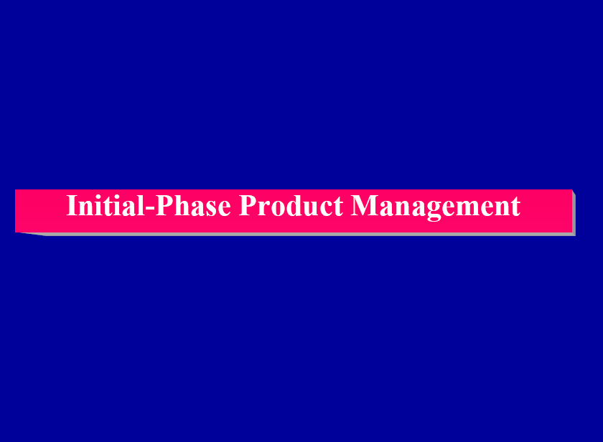

Slide 14
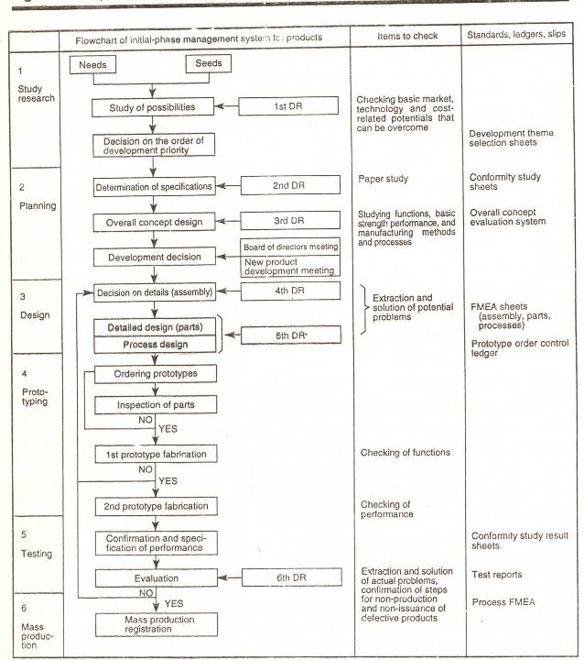
Initial Phase Management system for Products

Slide 15
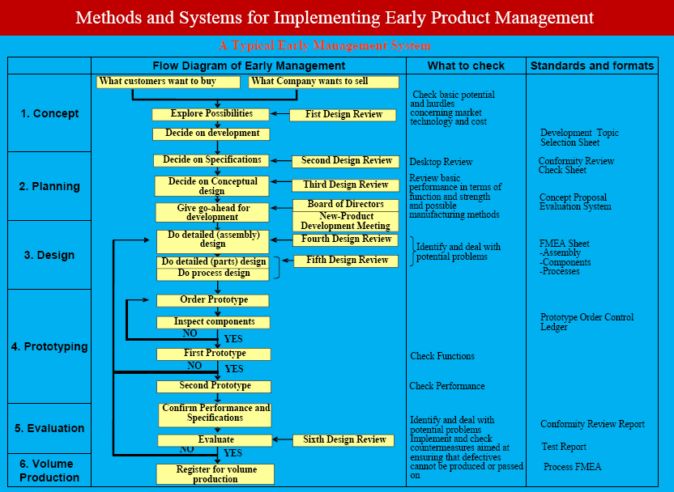

Slide 16
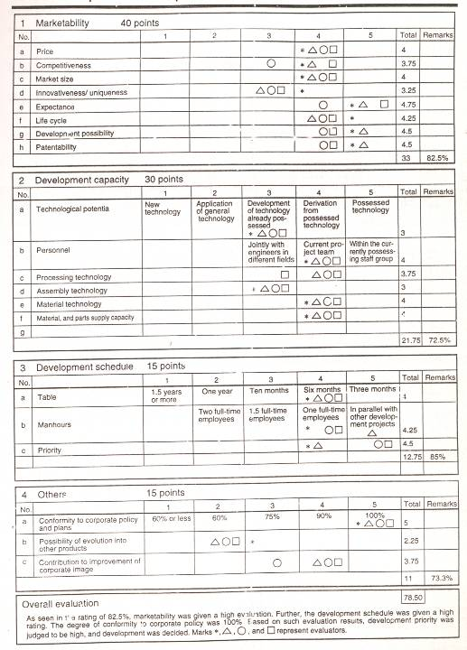
Development Theme selection sheet

Slide 17
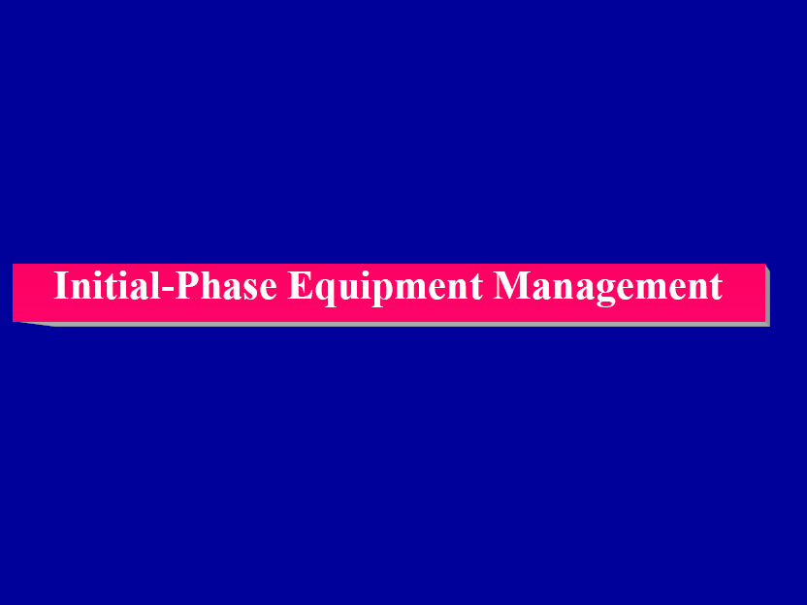

Slide 18
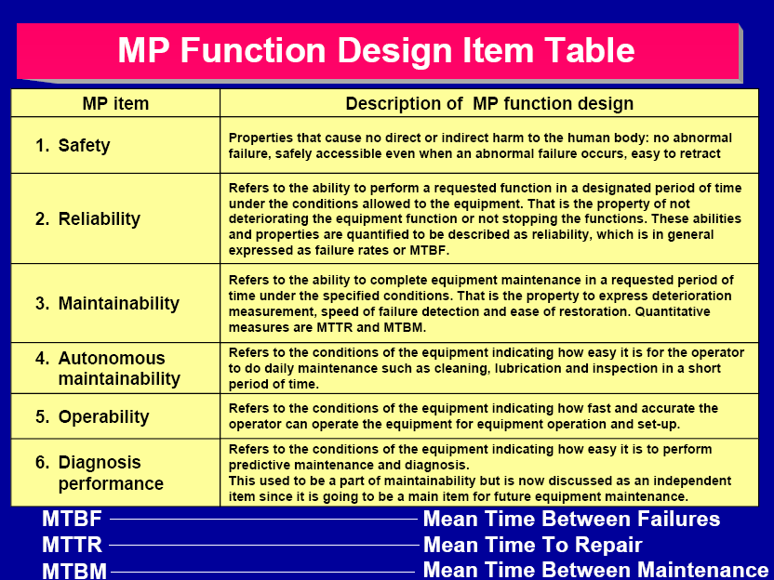

Slide 19
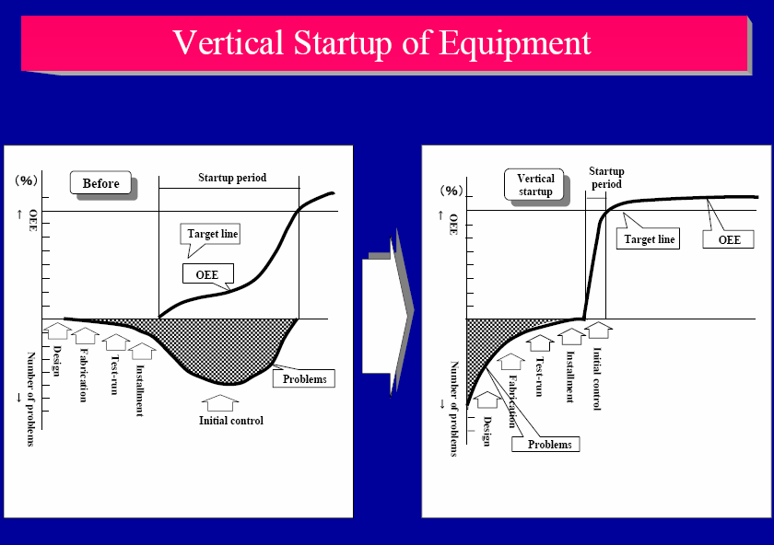

Slide 20
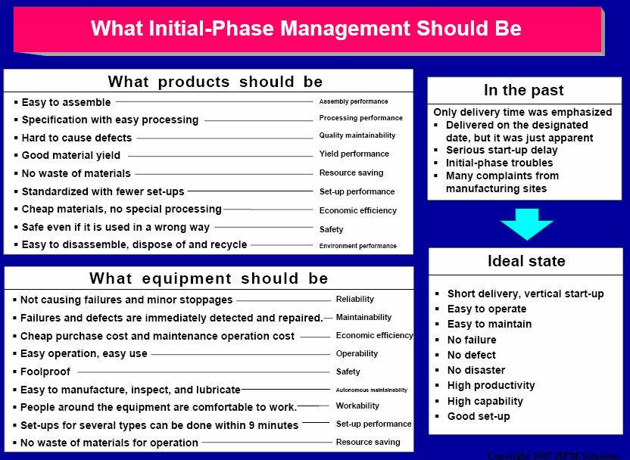

Slide 21
Company Example

Slide 22
Methodology – To Reduce Lead time
1. To reduce Product Design & Development lead time by 50%.
Study of existing development methods
Identifying Factors for delay
Study & Analysis of Factors
Identification of kaizen for time reduction
Establishing procedure for Activities

Slide 23
Typical Flow Chart for Development Activities
BEFPRE TPM
AFTER TPM
1.Customer
in-put
Customer Enquiry
Customer Enquiry
Market Requirement
Market Requirement
Review with Customer
2.Feasibility study
Feasibility Study
Feasibility Study
1st DR
Pre-BOM/Costing
Pre-BOM/Costing
Commercial Clearance
Commercial Clearance
3. Concept design
Pre-Design
Pre-Design
2nd DR
Customer Go ahead
Customer Go ahead
4. Proto-typing
Proto-Typing
Proto-Typing
Proto Assy & Verification
Proto part Inspection
NO
NO
Proto Assy & Verification
5 Detail
Design
YES
YES
Detail Design
DR
Detail Design
3rd DR
Dwg. Release for development
Dwg. Release for development

Slide 24
A Typical Flow Chart for Development Activities
BEFPRE TPM
AFTER TPM
6. Process Design
& Development.
Process & Tool design
DR
Process & Tool design
4th DR
NO
Process & Tool Development
NO
Process & Tool Development
NO
Process & Part Inspection
Process & Part Inspection
YES
YES
7. Product &
Process Validation
OTS Assembly
DR
OTS Assembly
5th DR
Product fitment/Validation
NO
Product fitment/Validation
YES
YES
Samples Sub. To Customer
Samples Sub. To Customer
Customer Go ahead
Customer Go ahead
8. Volume
Production
Pilot Lot Submission
Product Handover
6th DR
Customer Approval
Pilot Lot Submission
Mass Production
Customer Approval
Mass Production

Slide 25
Identifying factors for delay
1. Customer In-put
Delay in Customer requirement gathering.
2. Feasibility Study
Product cost estimation is time consuming.
Delay in product Feasibility study
3. Concept Design
Delay due to lack of member competency.
Delay due to lack of standardisation.
Delay due to lack of technical data.
4. Proto-Typing
Delay in proto-typing due to lack of facilities.
5. Detail Design
Delay due to lack of member competency.
6. Process Design
& Development.
Delay due to late Dwg & Document release.
Process design & dev. activity initiation after
completion of Detail design.
7. Product &
Process Validation
Delay due to more iteration in product
8.Volume Production
No product handover system for production

Slide 26
Study & Analysis of Factors
Delay in Customer requirement gathering.
Work flow before
Analysis of factor
Project initiation
Delay in Customer requirement gathering.
cust. Inputs / product spec measurements
All inputs not gathered at once
No formal meetings with cust
yes
Additional spec. inputs required
Concept design
No check points for In-puts verification
Proto-typing
Similarly Work flow & Factor analysys is conducted for all delay factors & kaizen identifications were done.

Slide 27
Study & Analysis of Factors
2.Product costing is time consuming
1. For product cost estimation we required following data
Molding M/C shift rates
Raw material rates kg.
M/C Hrs rate of machines
Tool steel rates per Kg
Work flow before
Analysis of factor
Project BOM
Project costing is time consuming
Component wt & M/c selection
Additional data required
why
Difficulty in filling cost calculation sheet
Data entry in costing sheet
Search for the data
why
Component costing
Data sheets for Raw Mat. Rate & m/c rates are not available
Project costing
Similarly Work flow & Factor analysys is conducted for all delay factors & kaizen identifications were done.

Slide 28
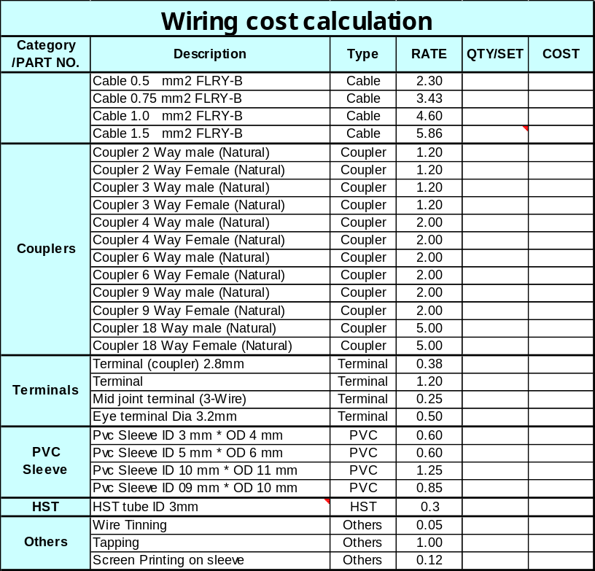
Establishing procedure for Activities
2.Product costing is time consuming
Work flow After
Data sheet for costing
Project BOM
Component wt & M/c selection
Data entry in costing sheet
Costing related data
Component costing
Project costing
Similarly Standard operating procedure are set for all delay activities.

Slide 29
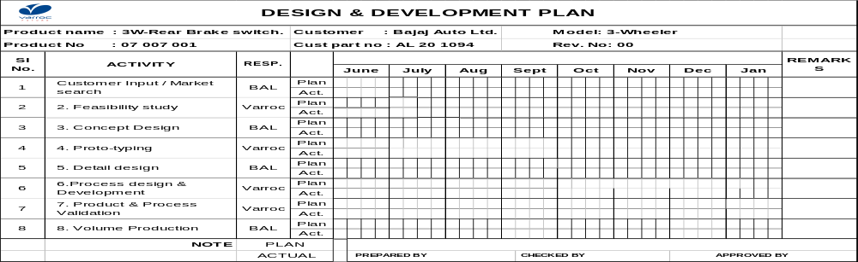
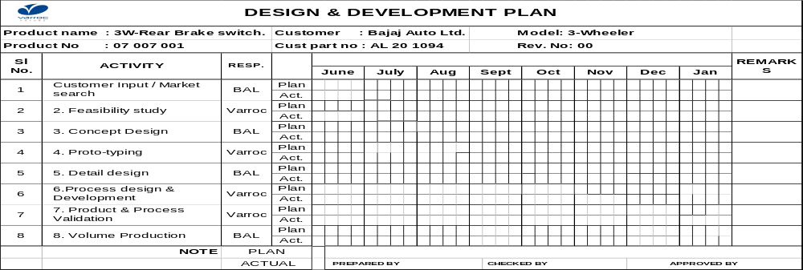
To reduce design & development lead time by
overlapping activities
BEFORE
AFTER
Overlapping of activities between 1. Proto-typing & Detail design 2. Detail design & process
design development is done to cut down lead time by 1 month

Slide 30
Methodology for First time right product
2. First Time Right Products 100%
DESIGN & DEVELOPMENT OF
FIRST TIME RIGHT PRODUCTS
DESIGN ANALYSIS/
VERIFICATION &
DESIGN REVIEWS
For all Products
PROTO-TYPING
For
New products
Referring at the
start of the design
THINGS GONE RIGHT
SHEET FOR EARLIER
PRODUCTS
PRODUCT DFMEA
For all Products
THINGS GONE WRONG
SHEET FOR EARLIER
PRODUCTS

Slide 31
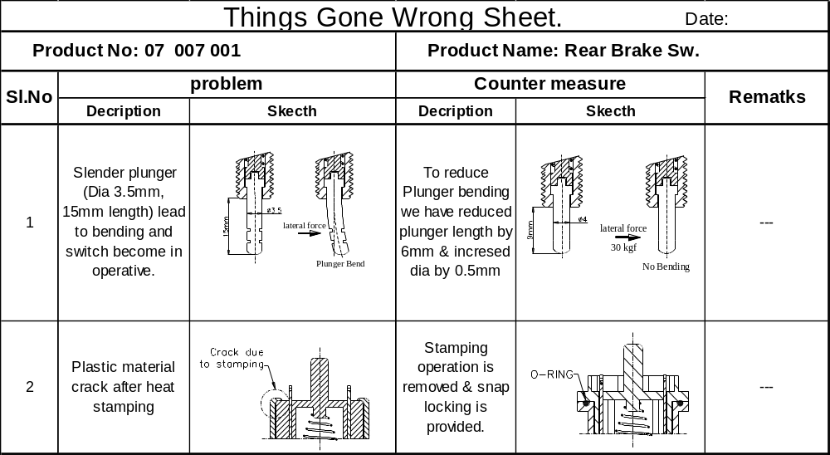
Things gone wrong sheet.
THINGS GONE WRONG SHEET FOR EARLIER PRODUCTS
Parellaly we are preparing things gone wrong sheet for rest all product families So, that we can prevent repetitive design errors

Slide 32
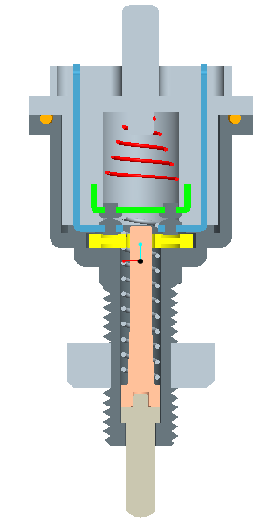
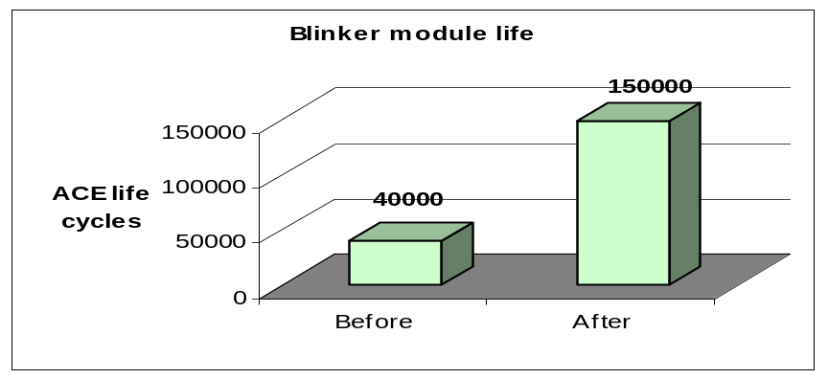
Kaizen (First time right)
Problem: Switch does not qualify during ACE testing
BEFORE
AFTER
Semi-sealed design to prevent dust & water entry
Earlier switches were getting fail
due to salt water & Dust entry on
contact points ( contact oxidation was taking place)
Water & dust entry prevented by providing o-ring
Benefits- Product reliability improved
by 300% In ACE testing.
good
Bad

Slide 33
THANK YOU

